Slide 1

高通量计算与热电材料设计
杨炯
上海大学材料基因组工程研究院
9/20/2016

Slide 2
概要
高通量计算
热电材料简介
热电材料中的高通量运用
总结与展望

Slide 3
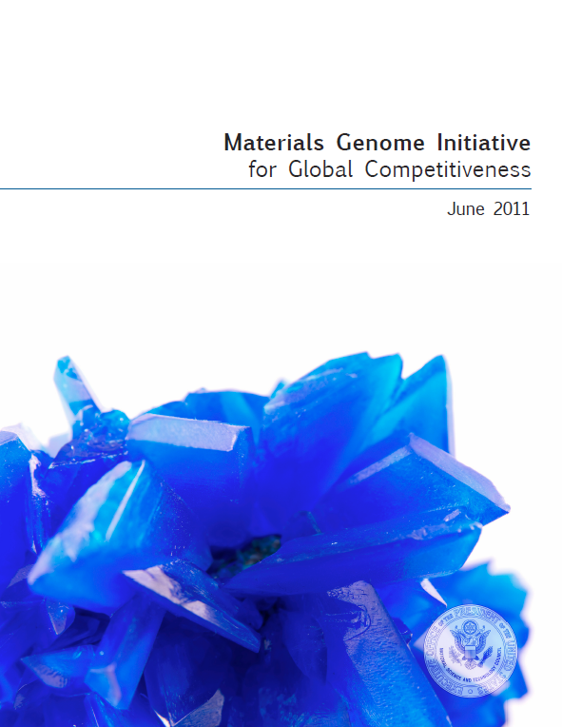
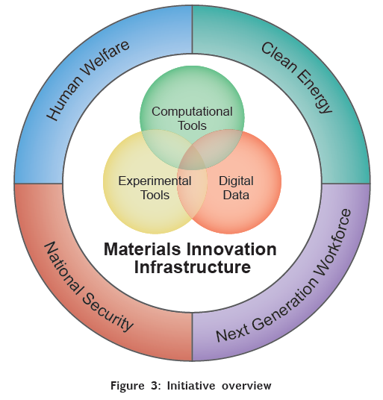
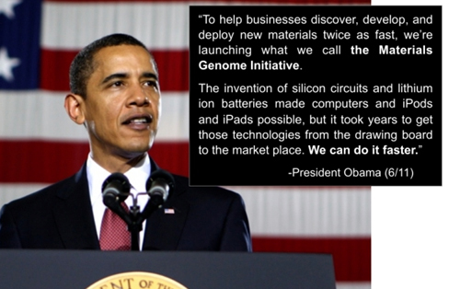
High throughput calculations
Half time, half cost!

Slide 4

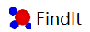
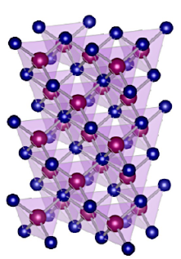
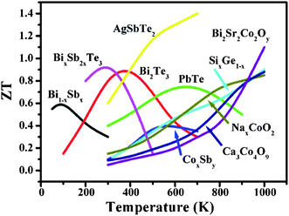
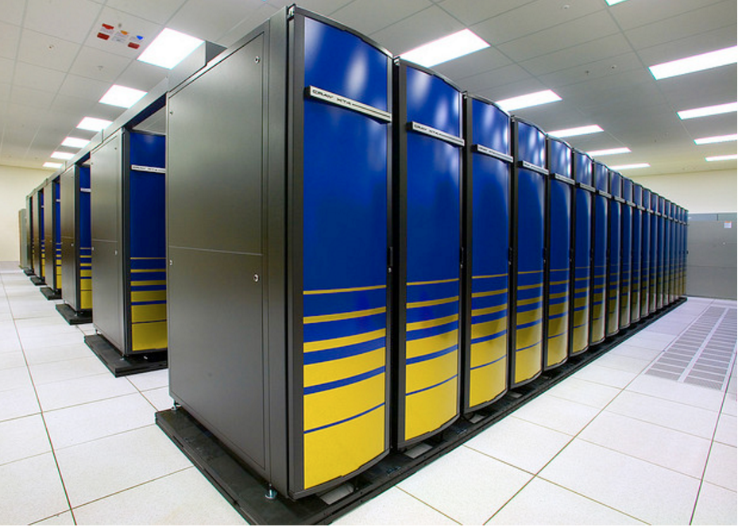


High throughput calculations
Property
descriptors
New candidates
Experiments
Notes:
从功能性质的角度讲，几大要素
DFT直接能得到什么？
Energy, electronic structures, elastic properties, (magnetic properties, diffusion barriers之类）
性质预测可能有多步，不同精度，或者是一些相关的讨论，比如dopability之类的东西

Slide 5
Property descriptors
计算
成本
高精度
高速
准确度
Notes:
最好有不同速度精度的组合，满足不同阶段的预测需要

Slide 6
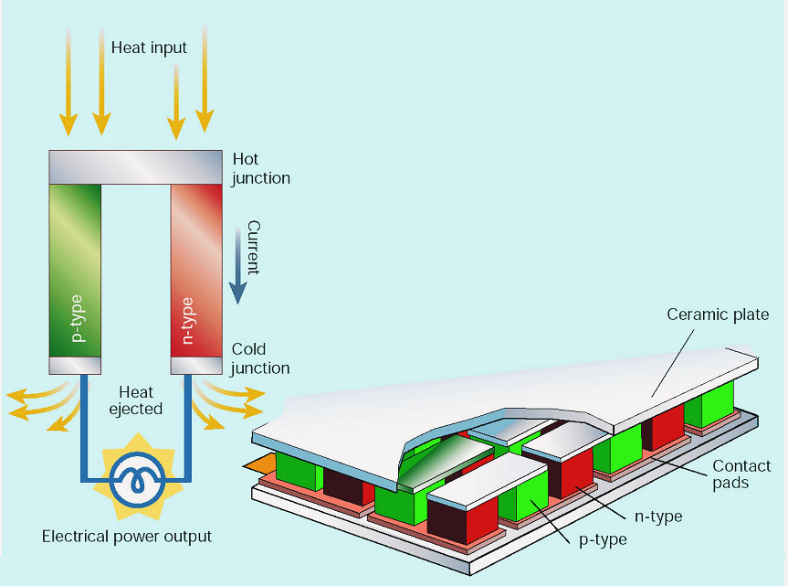
Basic thermoelectrics
Carnot efficiency
T_{h}
ΔV
S= ΔV /Δ T
ZT
T_{C}
T_{H}
T_{c}
Seebeck effect was discovered in 1821

Slide 7
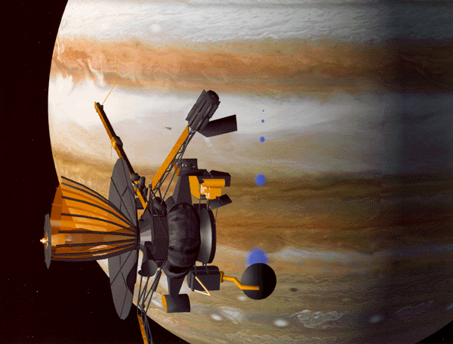
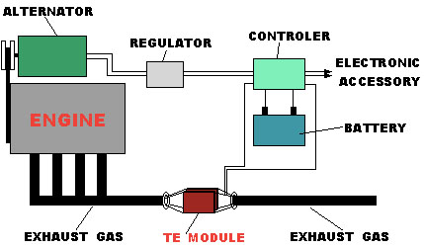
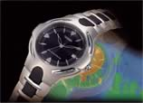
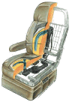
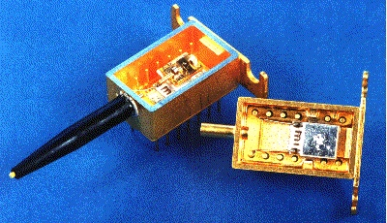
Basic thermoelectrics
TE power generation
Special power supply:
Space power, micro/nano-power
Recovery of waste heat energy:
Automobile engines, industrial furnaces, and others
TE refrigeration
Cooling element for electronic devices
Cooling system for car seat
Special air conditioner
Other coolers
GALILEO
TE generator using engine heat
Notes:
Advantage:
All solid state operation
Easily controllable electronically
Complete reversible for heating and cooling
Low noise and vibration, extremely reliable
No harmful refrigerants

Slide 8
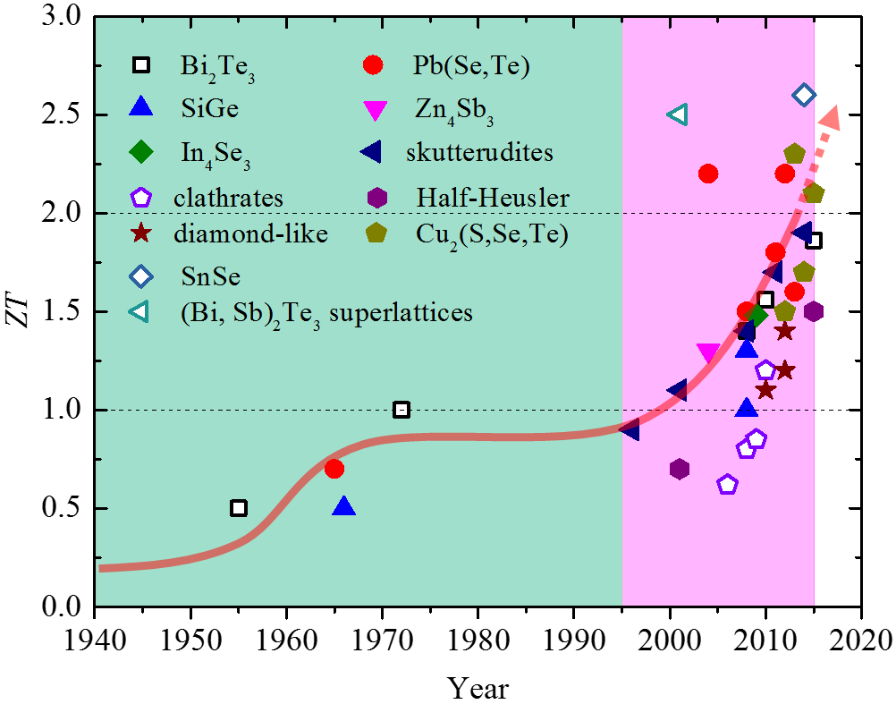
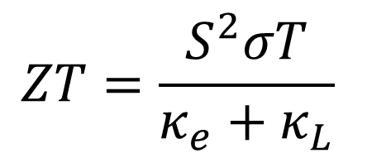
Basic thermoelectrics
Seebeck coefficient
Electrical conductivity
$$ZT=\frac{S^{2}σT}{κ_{e}+κ_{L}}$$
Thermal conductivity
Notes:
TE basics
ZT,
All parameters, why we need high PF and low k
E- and thermal- are the study focus

Slide 9
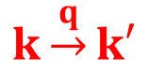
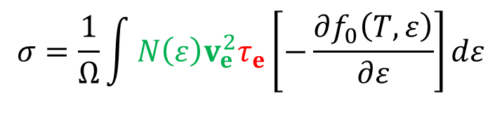
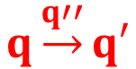
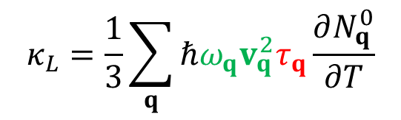
Basic thermoelectrics
dispersion
scattering
Electrical transport
Thermal transport
ε
$$σ=\frac{1}{Ω}\int{N\left(ε\right)v_{e}^{2}τ_{e}\left[−\frac{∂f_{0}\left(T,ε\right)}{∂ε}\right]dε}$$
$$k\underset{→}{q}k′$$
k
ω
Optic
$$κ_{L}=\frac{1}{3}\sum_{q}{ℏω_{q}v_{q}^{2}τ_{q}\frac{∂N_{q}^{0}}{∂T}}$$
$$q\underset{→}{q′′}q′$$
Acoustic
q

Slide 10
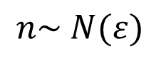
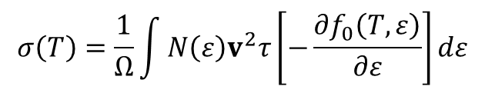
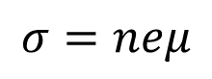

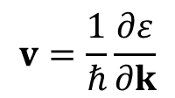
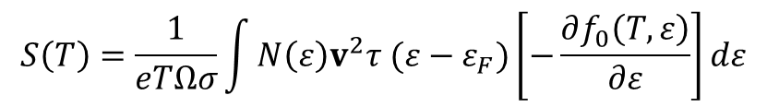
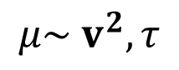
Electrical transport—dispersion part
$$σ\left(T\right)=\frac{1}{Ω}\int{N\left(ε\right)v^{2}τ\left[−\frac{∂f_{0}\left(T,ε\right)}{∂ε}\right]dε}$$
$$S\left(T\right)=\frac{1}{eTΩσ}\int{N\left(ε\right)v^{2}τ (ε−ε_{F})\left[−\frac{∂f_{0}\left(T,ε\right)}{∂ε}\right]dε}$$
$$v=\frac{1}{ℏ}\frac{∂ε}{∂k}$$
$$ε$$
S
S²σ
$$σ=neμ$$
σ
$$n\sim N(ε)$$
$$μ\sim v^{2}, τ$$
k
10¹⁹ ~10²¹ cm⁻³
n
BoltzTrap, Transoptic (VASP based)
Notes:
Conductivity macro –micro definitions，建立起载流子浓度，迁移率和微观的联系。
Seebeck和conductivity的相反关系的由来，配图

Slide 11
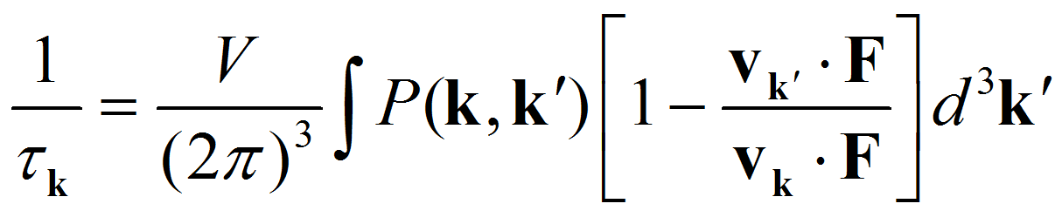
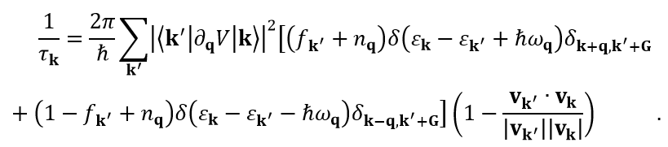

Electrical transport—scattering part
electron-phonon interaction
Still a challenge for theorists!
EPW (Quantum Espresso based)
Notes:
有许多种散射机制

Slide 12
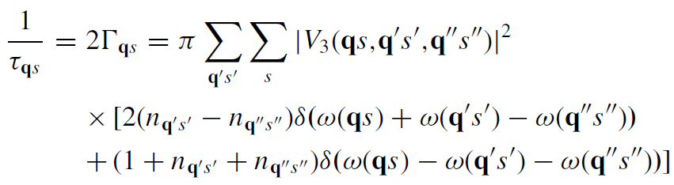
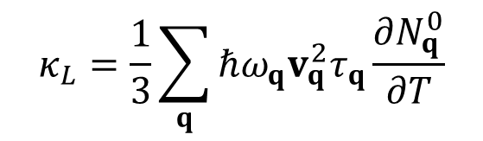
Thermal transport
$$κ_{L}=\frac{1}{3}\sum_{q}{ℏω_{q}v_{q}^{2}τ_{q}\frac{∂N_{q}^{0}}{∂T}}$$
Three phonon interaction
ω
Optic
Phonopy (VASP based)
Phono3py, ShengBTE (VASP based)
TDEP (VASP, LAMMPS based)
Acoustic
q
Notes:
能用弹性波理论的一个前提是声学声子占主导。
这在大部分情况下是合理的
shengBTE, phono3py

Slide 13


Thermoelectrics and high-throughput
Computational cost:
Dispersion (electron) < Dispersion (thermal) << scattering (electron) < scattering (thermal)
What people do?
Prediction of new materials
Develop high-throughput algorithms

Slide 14
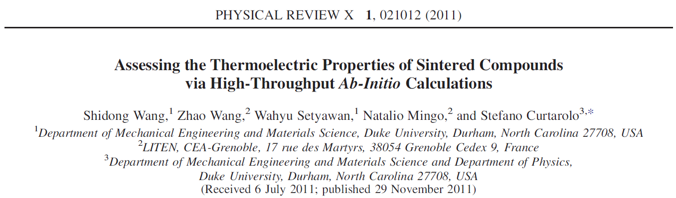
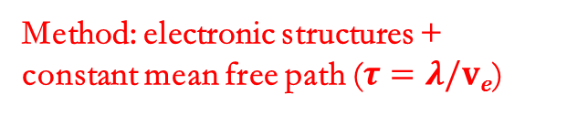
计算
成本
电输运
Database: AFLOWLIB, base on Inorganic Crystal Structure Database
System: > 2500 compounds
Goal: power factor ordering and its relation with electronic structures
高精度
热输运
高速
Method: electronic structures + constant mean free path ($τ=λ/ve$)
准确度

Slide 15
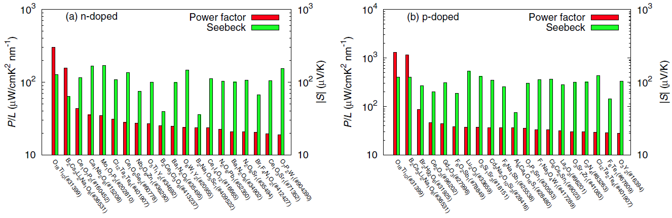
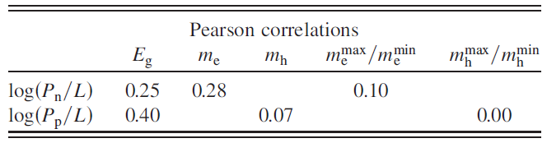
Major conclusions:
Propose new candidates
Weak correlation between P_{n}/L ~ m* E_{g}, based on the complex band structures
Good correlation between P and number of atoms
Notes:
性能高未必好，PF和许多因素有关，比如合成条件等等
大的有效质量对power factor有利之前只是在简单能带模型中成立；现在他们在复杂能带的情况下独立发现了这个结论，认为这是个重要发现
原子数与功率因子的关系比较有趣，但是只是一个数据规律，没有解释

Slide 16
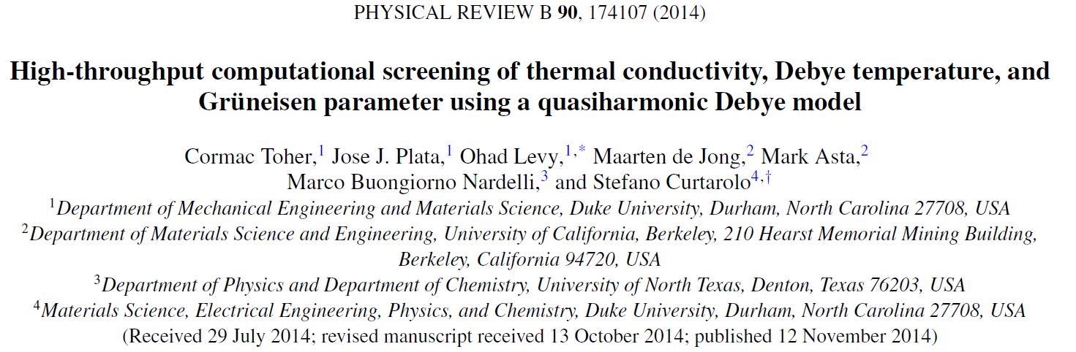
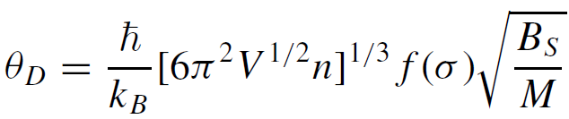
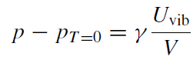
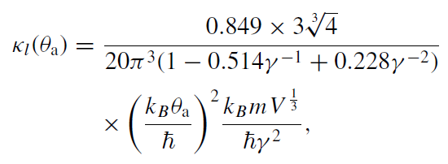
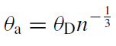
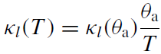
Database: AFLOWLIB
System: binary and ternary compounds in various structures
Goal: test the AGL method in κ_{L} evaluation
计算
成本
电输运
热输运
高精度
Method: Automatic GIBBS Library (AGL)
Using Gibbs free energy G( p, V, T ) for everything used in κ_{L}
高速
准确度

Slide 17
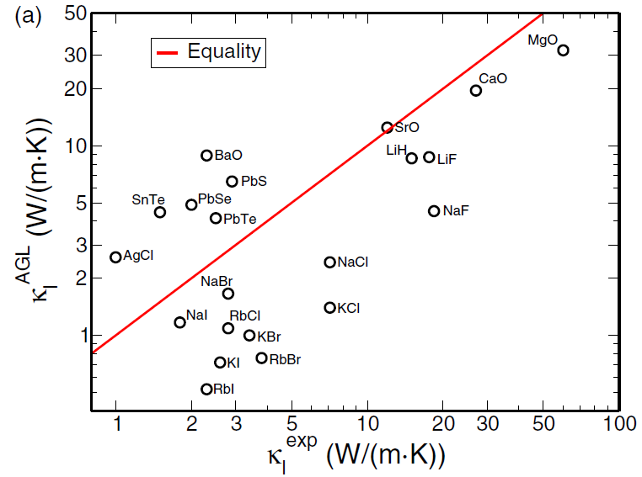
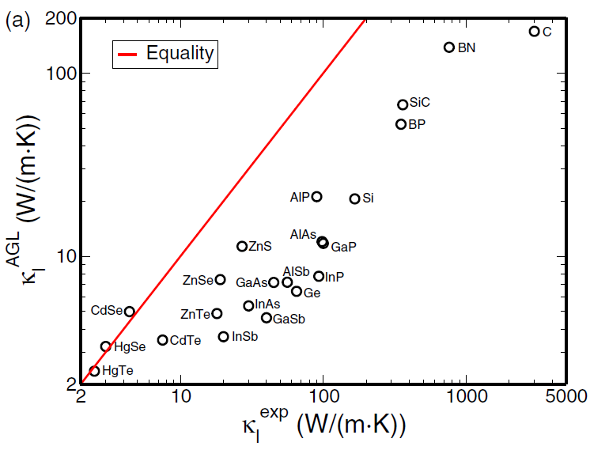
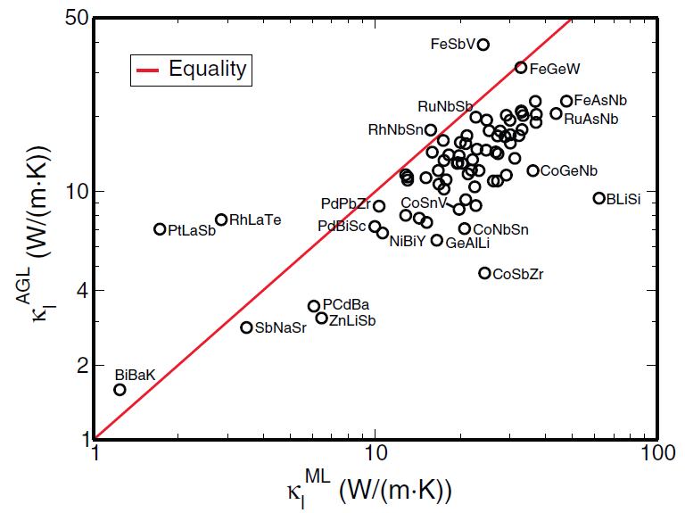
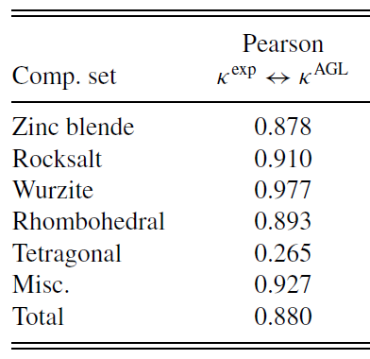
Major conclusions:
Propose the AGL method which is cheap.
AGL can reliably predict the ordinal ranking of κ_{L}

Slide 18
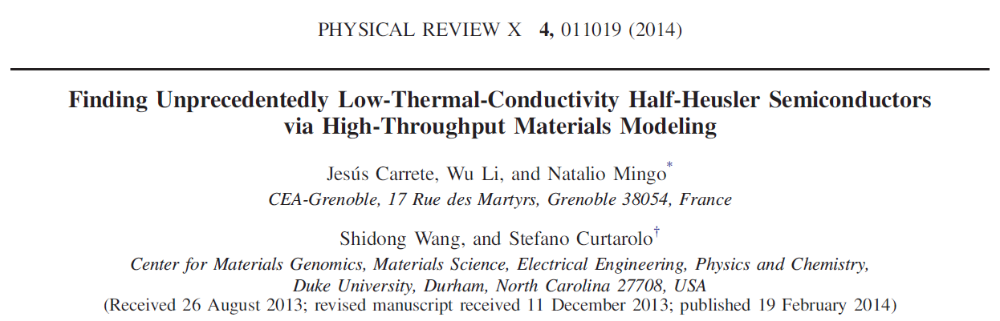
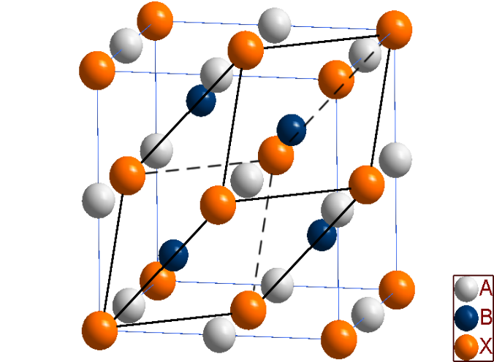
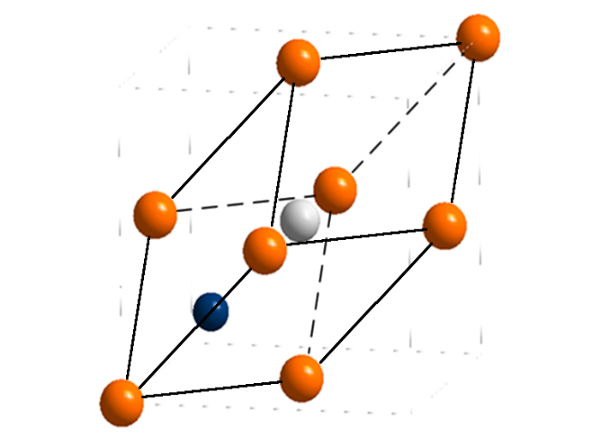

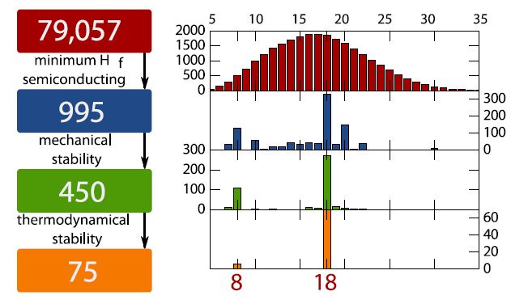
Database: AFLOWLIB
System: ternary half-Heusler
Goal: finding HHs with low κ_{L} (5W/m-K)
ABX
A
B
X
Notes:
kL< 5W/m-K
多级筛选， 79057→995元素形成能计算以及带隙；995→450，声子谱计算看虚频；450→75，其它二元和三元的竞争相

Slide 19
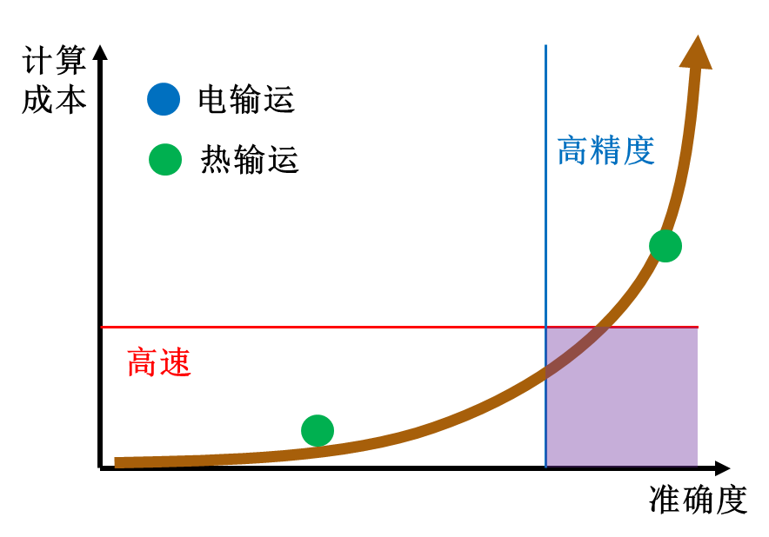
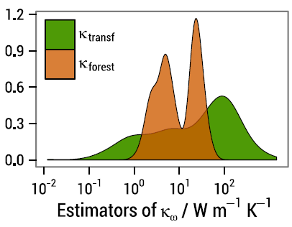
Reduce the computational cost from accurate three phonon calculations.
Method1 (κ_{transfer}): adopt the anharmonic force constant from Mg₂Si
Method2 (κ_{forrest}): random-forest regression with 32 fully calculated κ_{L} as a training set
Method3: find the principal components of third-order IFCs. 4/737. Accurate! But poor transferability among different symmetry
Several compositions with low κ_{L} are proposed BiBaK, PtLaSb, RhLaTe, SbNaSr
Notes:
Method1: 假设三阶力常数有可移植性，所以用一个结构相近材料的“三阶”力常数代替
Method2: 建立起热导率和材料一些本征属性的关系，以此来推测所有HH材料的热导率。本征属性包括元素化学性质（元素各类，电负性、半径），化合物特征（带隙，晶格常数，电荷），热导相关的二阶参数（热容，声速，三声子散射截面P3）。最后发现了很多数值关联。
Method3: 用了32个热导全计算的HH，发现其中每个HH需要737个irreducible IFC components, 但是只有4个为最关键，可大体代表HH的热导。16 DFT calculations
体现两个趋势：更大的数据量，准确度可控的方法（内行在做），数据科学的运用。方法3的可移植性也许可以通过将每一类对称性结构的材料的最重要组分找出来，建立结构-热导组元的对应表，然后可以解决。

Slide 20
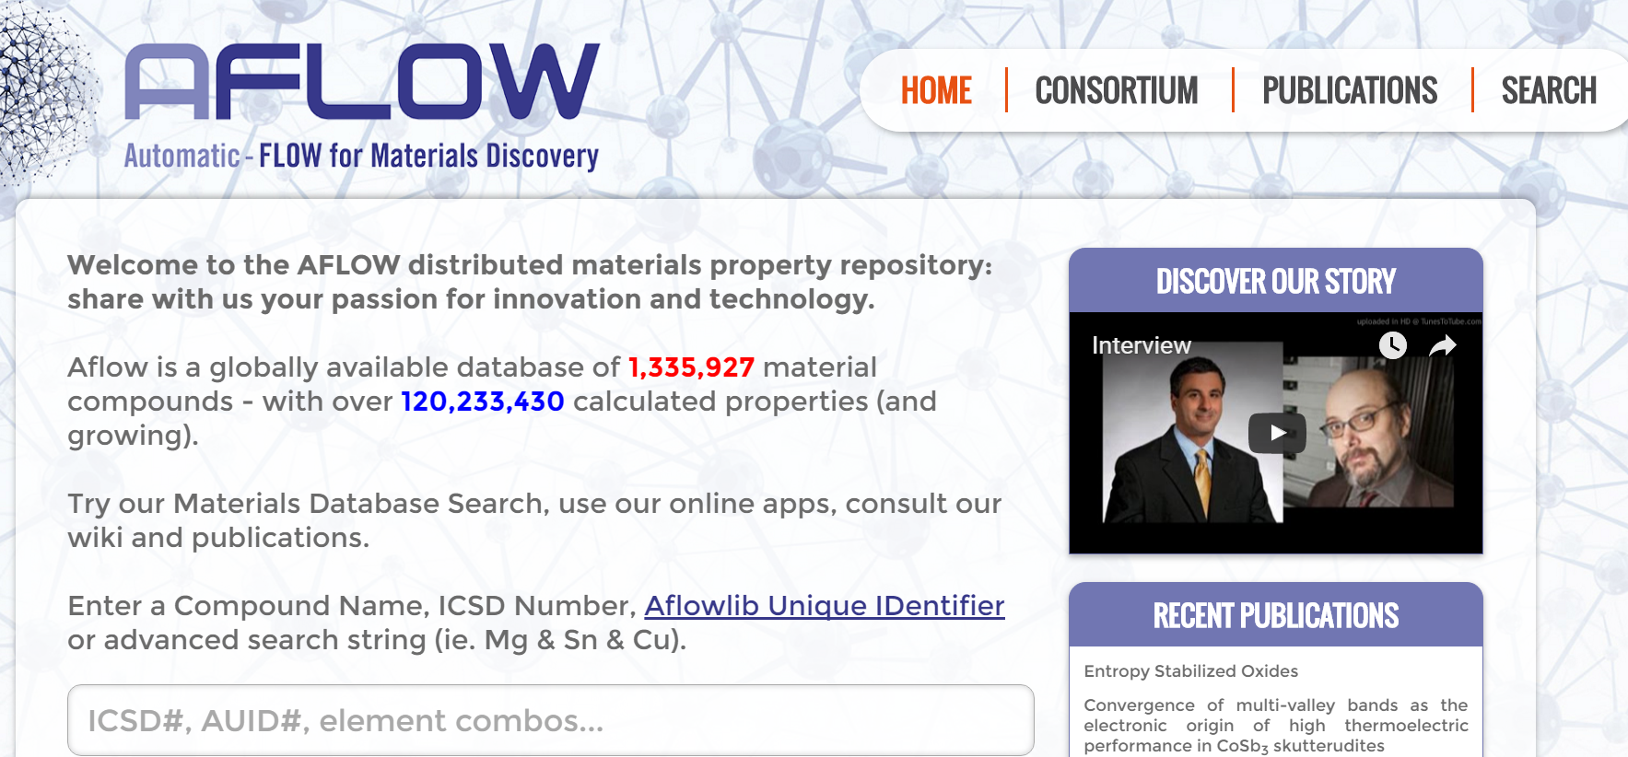

http://aflowlib.org/

Slide 21





Database: literature survey
Goal: semi-empirical approach for simple assessment of μ, m*, κ_{L}
s=1, t=2.5
Notes:
半个数量级的误差，这也是实验值的典型误差
考虑了散射中那些与三阶相互作用无关参数的影响，m*, 体模量或者弹性常数
我之前也有文章做过这方面内容，考虑了这些因素

Slide 22




Database: literature survey
Goal: semi-empirical approach for simple assessment of μ, m*, κ_{L}
Notes:
同时考虑了声学声子和光学声子
声速也不是算的，也是用体模量来估算的；与三声子相互作用相关的gruneisen系数不算了，扔在A1里面。与之前的AGL方法相关不大。

Slide 23

http://tedesignlab.org/
2303 compounds (as of 2016/09/17)

Slide 24

Database: Materials Project
System: ~9000 entries on MP
Goal: Find high ZT materials in a high-throughput fashions
Main conclusion:
Predict TmAgTe₂ and other XYZ₂ compounds
Poor experimental performance of TmAgTe₂

Slide 25




Method:
Ignore the third order interactions at all!
Constant relaxation time for e-transport
κ_{min} for ph-transport
Notes:
热电计算工作流
纵波横波声速通过体模量和剪切模量来计算
Kmin计算就无需知道三声子相互作用了。只计算当自由程达到最小可能值时的热导，只由二阶的声速决定！

Slide 26




Slide 27


Database: Materials Project
System: ~48770 entries on MP
Goal: classify the MP data in TE application
Method: Constant relaxation time for e-transport
κ_{min} for ph-transport
Notes:
数据中70%左右为氧化物，可想而知MP是一个以锂电池研究为基础的数据库
这个图是数据结果分类，
Doping是指n型好还是p型好
Isotropic是各向异性与否
Bandgap
Max PF
HHI 元素丰度

Slide 28


Pearson coefficient on
Seebeck coefficient 0.79
Power factor 0.33
Clustering materials by density-based spatial clustering of applications with noise (DBSCAN)
58 descriptors for each compound
Notes:
5431 candidates
该文章还是值得一读的。比较多的数据分类，以及相关性方法的应用，也提到了一些其它的高通量算法

Slide 29


Slide 30


Database: ICSD
System: ~100 half-Heuslers
Goal: searching for the HHs with high PFs
Method: Constant relaxation time for e-transport
J. Yang, W. Zhang, et al., Adv. Funct. Mater. (2008)

Slide 31




J. Yang, W. Zhang, et al., Adv. Funct. Mater. (2008)
Notes:
For a brief summay of simple HHs part,
First, Band gaps are mostly determined by elements at A and B sites.
Then, we give optimized doping levels that may provide guidance for experimental work.
And furthermore, by checking these two pics, we can give the promising new HH compounds that may possess good power factor.
For p-type materials, compounds with Cobalt, Ruthenium, Rhodium, iron atoms are good in power factor. But all of them need heavily doping since their DOS in top of the valence band are high. Some of the carrier concentrations are over ten to the power of 21 per cubic centimeter.
For n-type materials, some compounds with La and Y deserve to be tried. And the doping levels of them are not high, comparing with Co compounds.

Slide 32





Summary
计算
成本
电输运
热输运
高精度
高速
准确度
Notes:
都是很好的工作

Slide 33
Outlook
Build up the database
Improve the algorithms for transport calculations
Explore the structure-property relations
Manipulate the big data (?)
Notes:
第一条是由于别人的数据库虽开放，但是只支持少量数据一个一个检索，无法用来进行其它的高通量研究。
第二条，无法回避的散射问题。真正的难处就是解决散射相关计算的高通量化。这个也应该是高通量发展的核心。
第三条，提出高性能的组分未必只有性能计算这一条。通过一些构效关系的挖掘，也可以举一反三提出新的组分。这个往往效率更高。
最后一条是计算机方面的研究内容，我自己不太敢确定怎么做。不过不管怎么做，也需要基于准确的大数据。而这个“准确”，就需要算法的发展来保证

Slide 34

Our database —Materials Information Technology
The database in SHU
Source: ICSD+MP 130000+ doable entries for VASP

Slide 35

Potential HT algorithm for κ_{L}
Discrete mode properties, c_{qi}, v_{qi}, τ_{qi}
Assumption: cutoff frequency ω_{o}
Modified Callaway model* $κ_{i}={κ_{1,i}+κ}_{drift,i}, i=TA1, TA2, or LA$
Two phonon calculations (under both V₀ and V’) are needed
*Callaway, Phys. Rev. 113 1046 (1959)
Notes:
直接处理与散射相关的高阶力常数，不忽悠

Slide 36
Potential HT algorithm for κ_{L}
κ_{L}s of 14 compounds with very different chemical natures have been studied. The agreements are reasonable.
Pearson correlation coefficient: 0.9998
Notes:
κ_{L}s would be overestimated for compounds with the acoustic-optic interaction if not considering the ω_{o}.

Slide 37

Potential HT algorithm for κ_{L}
Much faster than accurate third-order IFC calculations
For YbFe₄Sb₁₂, 6 (this work) vs. 972 displacements (IFC)
Faster and better transferability than the one in PRX
For HHs, 3 (this work) vs. 16 displacements (PRX)
Notes:
别人的这个16个displacements是通过对称性分析得到的。我们是universal的方法。
要做的就是高通量化，包括自动化流程，自动纠错等等。。

Slide 38





The simplified algorithms for carrier scattering
Elastic scattering
Long wave limit +complex band
Long wave limit +single parabolic band
Constant
$$\frac{1}{τ\left(k\right)}=\frac{1}{τ_{0}}$$

Slide 39

How to deal with the e-ph matrix?
Deformation potential E₁(k)
Ultimate goal: direct calculate the matrix, with some constraints.
Notes:
形变势方法中，利用准确的DFPT计算，而不是questionable core level alignment.
尝试建立E1和电子结构的关系，将唯一的高阶参数转换为二阶能带参数的函数！
终极目标中，限定条件可以是根据热电材料只在小能量范围有贡献的特点，限定只计算很小范围内的矩阵元而把其它元素归零。或者是学习之前那篇很精确的方法，利用机器学习搞明白矩阵元中最重要的部分，只计算相关矩阵元的，其它插值的做法。

Slide 40



Structure-property relations
The splitting energy of crystal field Δ_{CF} in tetragonal chalcopyrite is related to η (=c/2a)
Reveal the “unity η” rule（Δ_{CF=0} ）, useful for material screening.
J. W. Zhang, W. Zhang, et. al , Adv. Mater. 26, 3848, 2014

Slide 41


Structure-property relations
Use the solid solution between compounds with both η<1 and η>1;
Three solid solution systems are designed;
The solid solution of CuInTe2 and AgInTe2 is experimentally verified. Great enhancement of ZT is observed.
J. W. Zhang, W. Zhang, et. al , Adv. Mater. 26, 3848, 2014

Slide 42

Thank you!

Slide 43

High throughput and thermoelectrics
Rigid band approximation
Ignore the influence of dopants on band structures!

Slide 44
个人简介
教育经历：
华东师范大学化学系 化学 学士学位 09/2000-07/2004
中国科学院上海硅酸盐研究所
材料科学与工程 博士学位 08/2004-07/2009
工作经历：
中国科学院上海硅酸盐研究所 助理研究员 08/2009-01/2012
美国华盛顿大学 材料科学与工程系 博士后 02/2012-04/2015
上海大学 材料基因组工程研究院 教授，东方学者 05/2015-

